Slide 1
PARENT COUNCIL
11/19/20

Slide 2
Agenda
Student Activities
Music
Athletics
Teaching & Learning
Guidance
Health & Safety Plan
Technology
FAQ

Slide 3
Parent Council Norms
Be Respectful & Considerate – of other people’s thoughts and opinions
Be Responsible – ready to begin on time, be prepared, and maintain joy
Be Healthy – create a safe meeting environment where all feel comfortable enough to share their thoughts

Slide 4
School Reminders & Updates
School Daily Announcement Email – Daily Announcements & Weekly Updates
Attendance – holicongattendance@cbsd.org
Students cannot “excuse” themselves
“Switching” Hybrid – please email counselor & administration
Lasts for entire marking period

Slide 5
Superintendent Parent Advisory
Health & Safety – Schools Update
Canvas – Parent
Assessment & Grading

Slide 6
Student Activities
Student Activities Page
Information on clubs & extracurricular activities
Holicong Video Page – “Homebase”
Our Story, Songfests, Mornings Show, and Shout Outs!
Thanksgiving Food Drive
In school collection wrapped up on Tuesday
Monetary donations open in My Payments Plus until Friday
Holicong Families & Local Food Pantries
Winter Spirit Week - December 14th-18th
Winter hat day
Winter socks day
Comfy clothes day
College shirt day

Slide 7
Holicong Yearbook
2020-2021

Slide 8
Help needed…
Student yearbook staff-forming now
Interested students listen to announcements
We need candid pictures! jlock@cbsd.org
First day(s)
Virtual day(s)
Spirit days
Sports competitions
Clubs/school activities

Slide 9
The next meeting of the Humanitarians of Holicong will be Wed. Nov. 17 at 2:50 via TEAMS. Anyone can join. Email Mrs. Keyes for your link invitation.
This Photo by Unknown Author is licensed under CC BY-NC-ND

Slide 10
P.O.P.S. Club Meeting Today @2:50 through Teams
All students are invited to join this information meeting. Email Mrs. Louderback blouderback@cbsd.org for the meeting link.

Slide 11
Music
Coffeehouse Tonight 7 pm
Music and poetry performances by Holicong students &staff
Original student work is great, but you can also perform your favorite song/poem written by someone else
Songfest #4: Instrumental Only – Tuesday December 1st 7 pm
Band and orchestra instruments, guitarists, pianists and all other instruments welcome
Sign up to perform by emailing Mrs. Repper (jrepper@cbsd.org) by Tuesday 11/24
Holicong Music Store – t-shirts, hoodies, sweatshirts, masks and more!

Slide 12
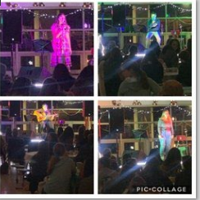
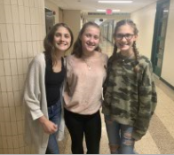
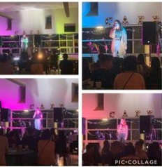
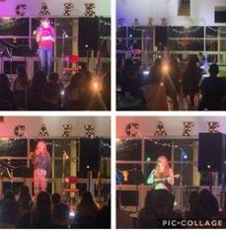

Slide 13
Athletics
Winter Sports – Girls & Boys Basketball, Cheerleading, & Wrestling
Girls basketball tryouts on going (halted based on information below)
Wrestling tentative start date is November 30th
Updates from today – information is fluid
Must wear masks in competition
Basketball “capped” at 12 players per team
Gym Capacity – Our gym is large – still 2 passes per household
Reminders:
Passes – Parents should have 2 passes per household. Thanks to Mrs. Loughlin for the idea to make these business cards. Please have these at games.
Health & Safety Plan – Thank you to everyone for following the guidelines for games (social distance, masks, etc.) We have had absolutely ZERO issues. For winter:
Bleachers – 6 feet minimum distancing with circle stickers where to sit
Scorers Tables & Player Chairs – Taped on floor for social distancing
https://www.pa.gov/guides/responding-to-covid-19/
Face Coverings – https://www.governor.pa.gov/wp-content/uploads/2020/11/20201117-SOH-Universal-Face-Coverings-Order-Update.pdf
Travel Order – https://www.health.pa.gov/topics/disease/coronavirus/Pages/Travelers.aspx
All athletic activities will be cancelled on Wednesday, November 18 and Thursday, November 19, 2020. More information forthcoming and announced at end of day today!
Notes:
Basketball Teams capped at 12 players

Slide 14
Guidance
MBIT – Open House & Live Meeting
Guidance Groups – First Set
Family Support
Stress Management & Mindfulness
Organization & Executive Function
Wellness Survey
Results from Wellness Survey to Students
Naviance – Click here to get right to it!

Slide 15
Teaching & Learning
Congratulations on a great 1st marking period
The key to success is similar to other years relationships and flexibility
Communication is still vital between students and teachers
Grading Updates
90/10 & Formative & Summative
Academic Remediation – Tuesday & Thursday after School

Slide 16
Assessment & Grading
Purpose of a Grade: It is our belief that a grade should be an accurate measure of what students know and their ability to apply & demonstrate their learning at the time they are assessed.
Types of Formative/Practice Assessments: 10%
Assessments “for” learning – feedback provided; skills developed
Analogies: Basketball practice, rehearsals
May include but not limited to: Homework, Classwork (handouts, notes), Practice Quizzes, Labs, Journals, Class Participation.
Types of Summative Assessments: 90%
Assessments “of” learning – feedback provided; skills developed
Analogies: Basketball game, performance
May include but not limited to: Tests, Papers, Projects, Core Assessments, Midterms, DBQ’s, Labs, Quizzes

Slide 17
FAQ from First Meeting
Is the 90% summative to 10% formative grading guidelines for the rest of the school year?
As we know now this will continue for the rest of the school year, if there would be a change, we would communicate to everyone.
What is the second chance policy?
Currently department specific, but we are working on a consistent policy for all Central Bucks Secondary. Will share with students and community in the coming weeks.
Communication going forward…
This was included in the Weekly Update. Wanted to have Parent Council meeting first and feedback from parents if more information needed.

Slide 18
FAQ from First Meeting
What if student has difficulty submitting assignments or unclear where or how to submit?
Communicate with teachers if an issue with technology or submitting assignment – and explain issue and we will be understanding. If something continues – that is the struggle when not having students here in person. If it “technology” training that is one issue…but if continuously handing in things late it would be an issue that would involve teacher, parent, & student focusing on what can be done to get this work in.

Slide 19
Trends/Reminders from 1st Period
Online Students
Student Cameras on at beginning of class
Ready & Engaged in Learning (environment)
Will review expectations after Thanksgiving break
Work Submission – “the consequence of not doing the work is doing the work!”
Communication – Lots of it! With students & teachers – plan for “tying in parents” to complete the triangle

Slide 20
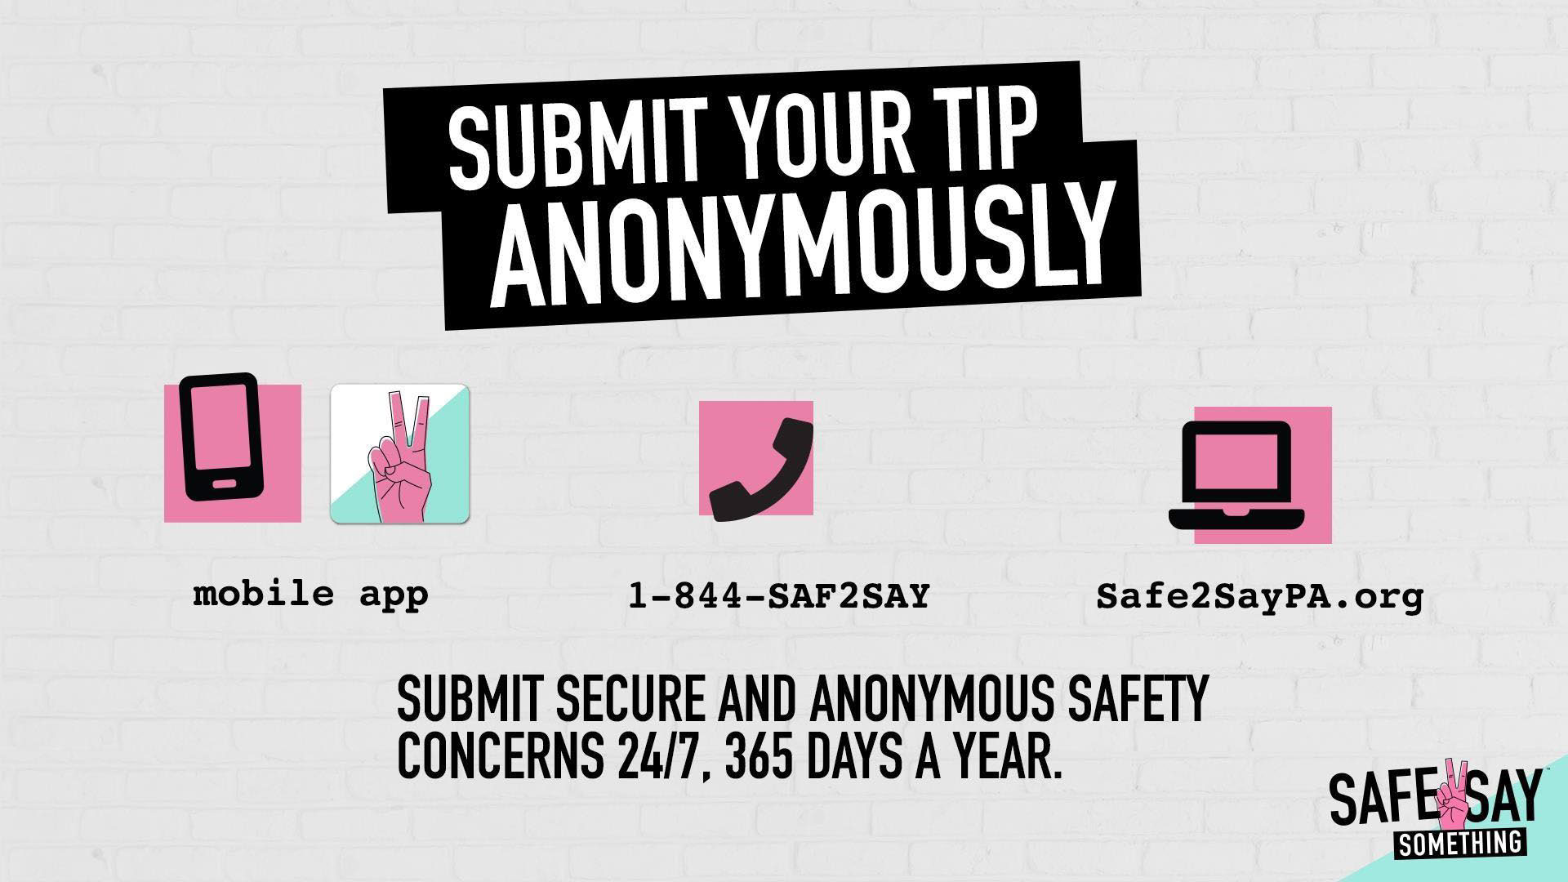
Health & Safety Plan
Safe2Say Presentation - https://www.cbsd.org/domain/2702

Slide 21
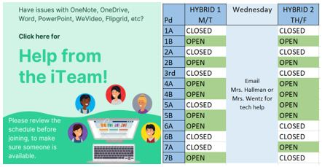
Technology
Canvas Tutorial & Grade Access Video – Recommendation from last meeting
iTeam – link on each grade’s Library Canvas site

Slide 22
FAQ

Slide 23
FAQ

Slide 24
PARENT COUNCIL
11/19/20

